Slide 1


Computer Architectures
& Operating Systems
Project – HaclOSsim
Academic Year 2023/2024
Group No. 09
s323386 – Antonio Capece
s328833 – Federico Cagnazzo
s331031 – Giovanni de Maria s331618 – Andrea Carcagnì

Slide 2


Project Goals
Acquire proficiency in utilizing an embedded operating system on QEMU
Customize the chosen operating system (FreeRTOS) to implement a new feature
Evaluate on significant workloads
2

Slide 3
FreeRTOS
Real-Time OS for Microcontrollers
FreeRTOS is an open-source real-time operating system kernel for embedded systems, widely used in microcontrollers and small microprocessors.
It provides a set of software tools and libraries that facilitate the development of embedded systems with real-time constraints.
Distributed freely under the MIT open-source license, FreeRTOS includes a kernel.
FreeRTOS is built with an emphasis on reliability and ease of use.
Most recent threats, i.e., Spectre, etc.
3

Slide 4
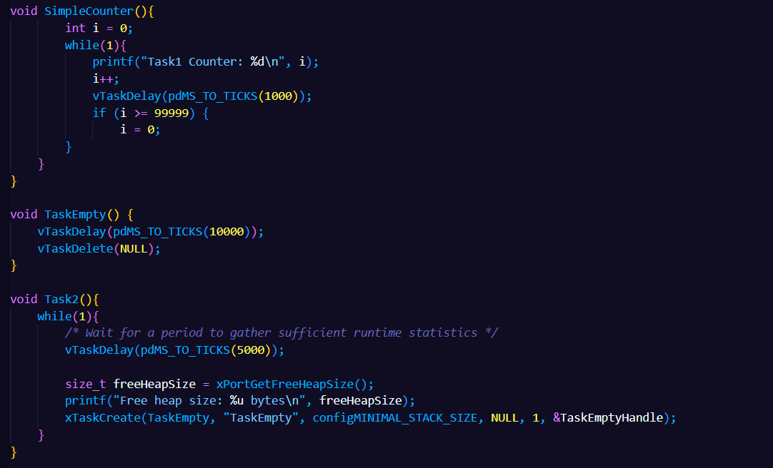
demoStats.c
This program is an example to show how much space
remains unallocated in the heap.
It creates two tasks, run concurrently. The former is a simple counter, the latter creates each time a new empty task and after call the xPortGetFreeHeapSize() function (after a delay),
which returns the total
amount of heap that remains unallocated.
aria
4

Slide 5
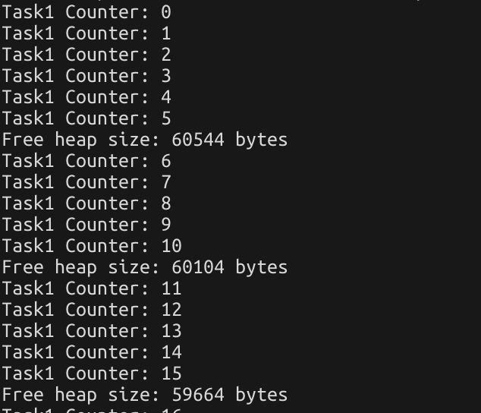
demoStats.c - Output
aria
Running the demo, we can see how the heap unallocated is less each time a new task is created and is running.
When a task terminates, the heap occupied is automatically deallocated.
5

Slide 6
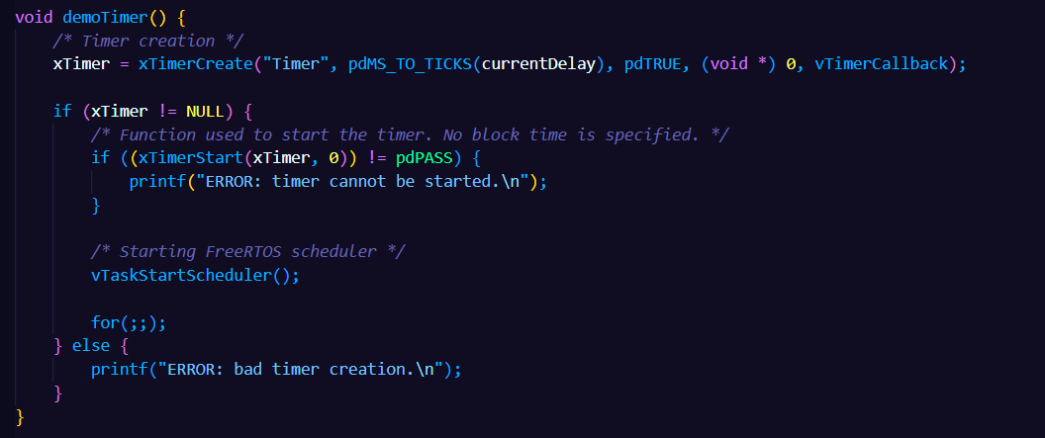
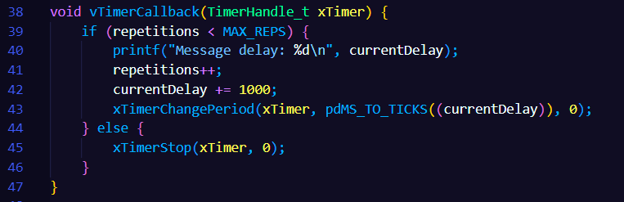
demoTimer.c
The program is an example used to make simpler to understand a basic function of FreeRTOS as timers.
A message is printed on the console after an increasing timeout.
After each print, the delay is increased of 1 second.
6

Slide 7
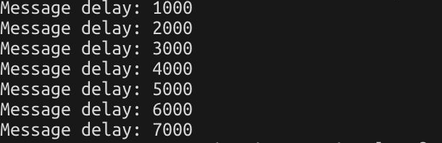
demoTimer.c - Output
The following is the obtained output, after running the demo.
We can notice the incremental delay printed in the output message.
7

Slide 8
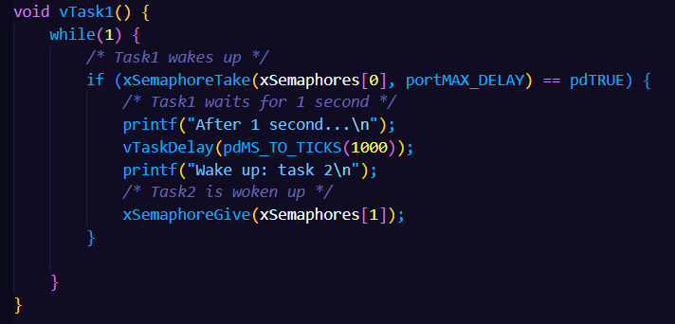
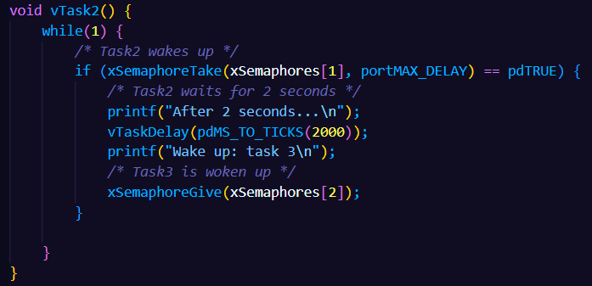
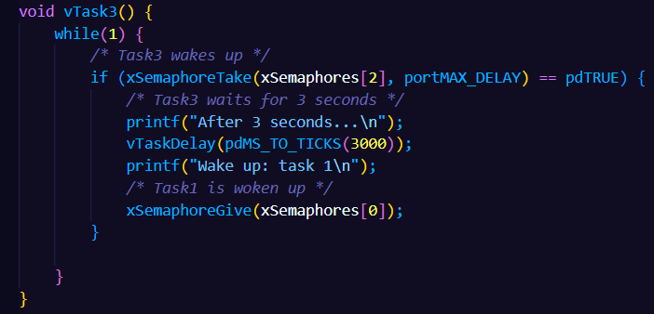
demoSemaphores.c
The program implements three mutex semaphores and three tasks which access a critical section, in which a message is printed and are used respectively timers delays of 1, 2, and 3 seconds.
When a task accesses the critical section, the other two remained blocked.
When it finishes, it unblocks the following task. This is performed cyclically.
8

Slide 9
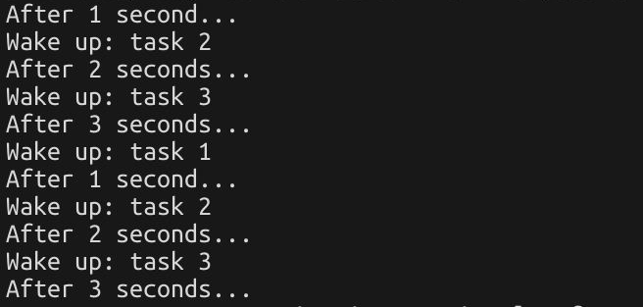
demoSemaphores.c - Output
This is the obtained output after running the demo.
It is shown the circular running of the three tasks, which access the critical section in mutual exclusion and, after performing operation in this section, the following task is woke up.
9

Slide 10
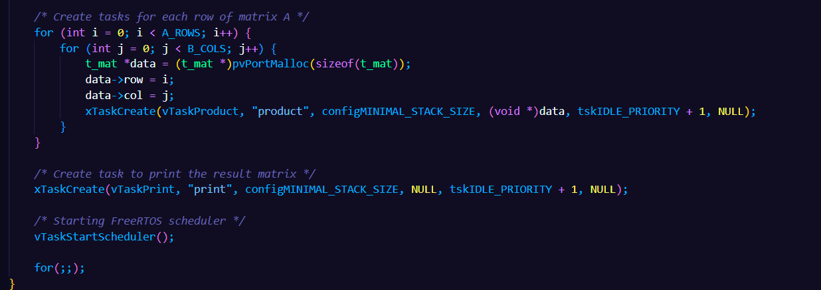
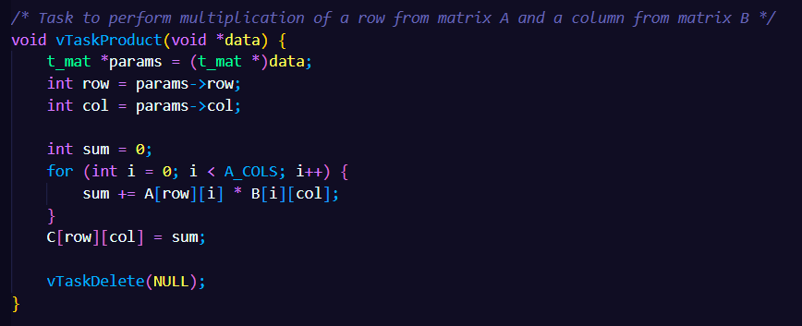
demoMatrix.c
The program implements a multiplication between two matrices, A and B.
It creates N tasks, one for each result that need to be computed and assigned to the result matrix C.
These tasks are run in parallel and only after their computation, another task is created to print the matrix C, containing the result of the multiplication.
10

Slide 11
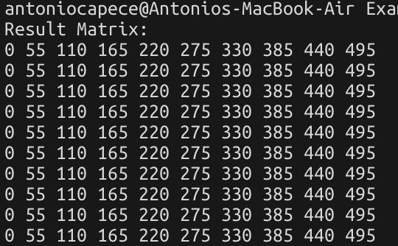
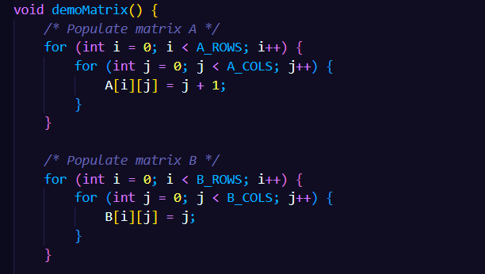
demoMatrix.c - Output
Before starting the multiplication, we populate the two matrices in the following way.
The result matrix is obtained very fast since we can parallelize the operations.
11

Slide 12
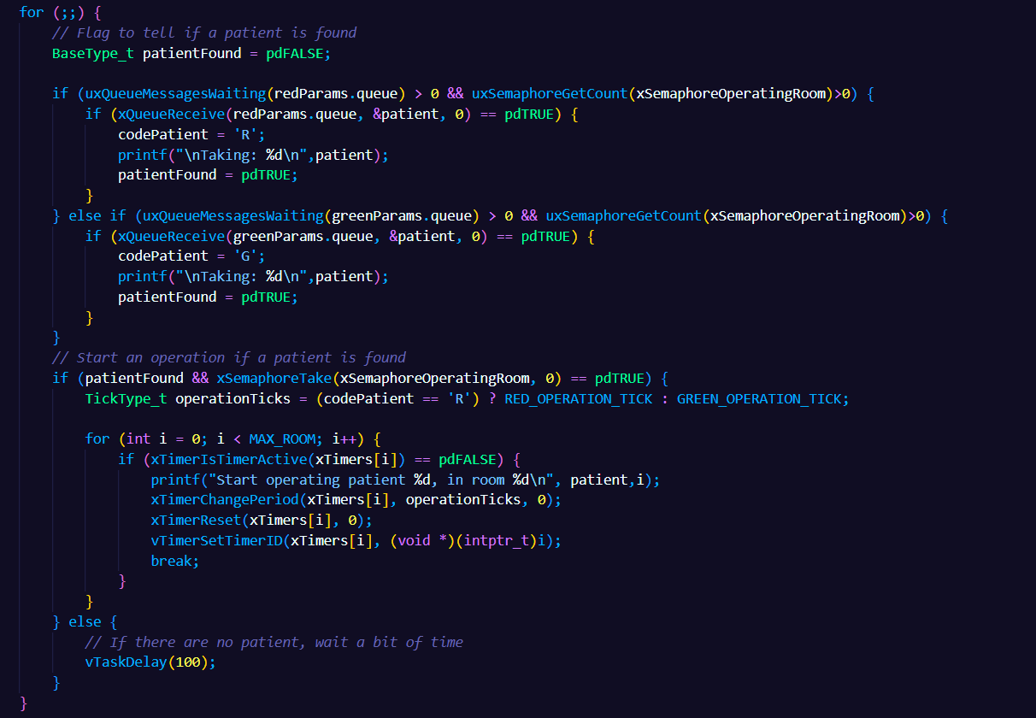
demoHospital.c
This demo simulates the management of a hospital system.
The hospital has a limited number of operating rooms, with only one patient being operated on at a time in each room. Patients are operated on based on a priority system determined by color codes, which define the priority and the duration time of the operation.
12

Slide 13
demoHospital.c
Queues: used to maintain the list of patients waiting for surgery.
There are separate queues for code red and green patients. Tasks fill these queues with patient arrival times.
Semaphore: managing concurrent access to operating rooms, when a room is available, the semaphore is taken (xSemaphoreTake) and then released (xSemaphoreGive) when the operation is completed.
Multitasking: fillQueue and operatingRoomTask manage patient arrival and operation in operating rooms, working in parallel, allowing realistic simulation of the hospital environment.
Timer: they manage the duration of operations in each operating room.
13

Slide 14
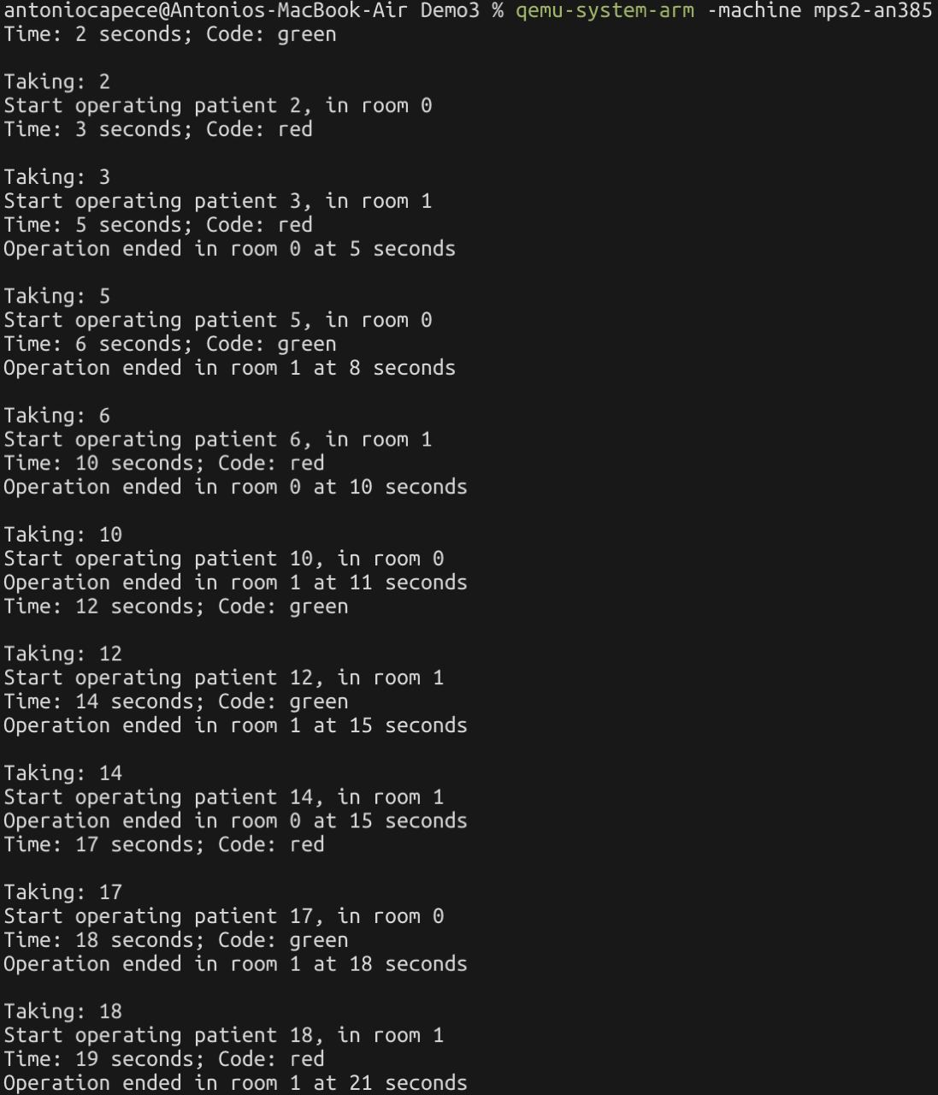
demoHospital.c - Output
This is the resulting scheduling of the incoming patients, based on their priority and on the current condition of the surgery room (free or occupied).
14

Slide 15
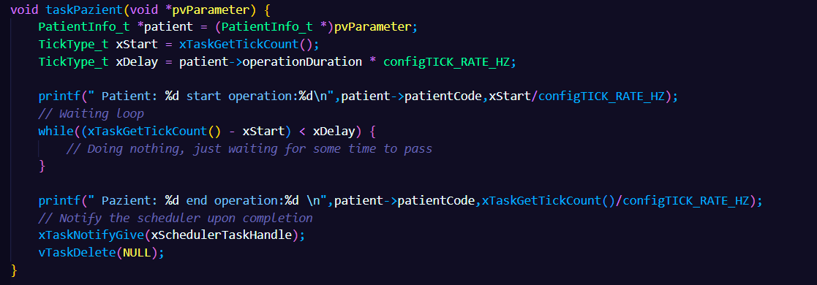
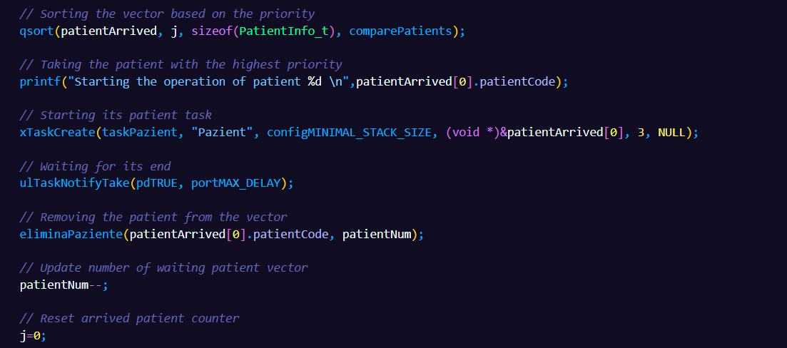
demoHospital2.c
This demo represents an improvement over the previous hospital management system, with new functionalities and optimizations to better manage patient operations based on priorities.
The additional functionalities include managing patient priorities, removing patients from the list in case of death, and enhancing operation management using task notifications.
15

Slide 16
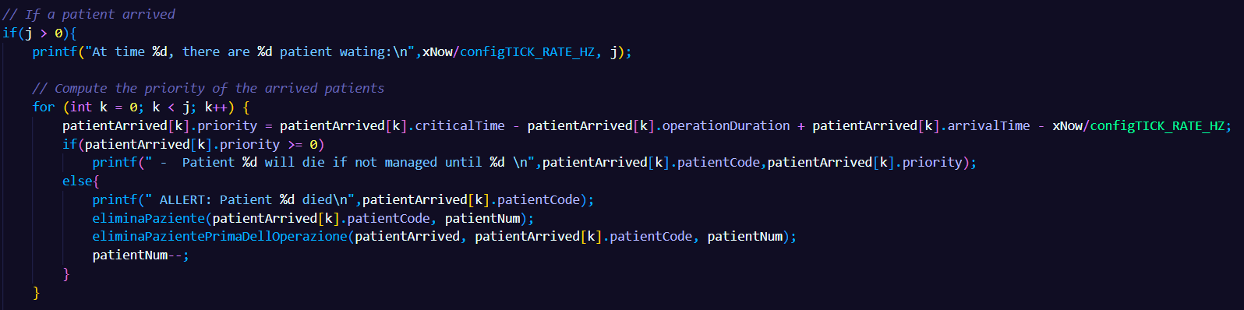
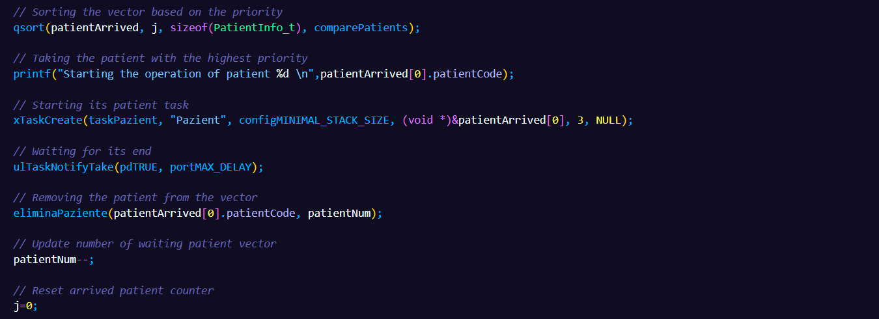
demoHospital2.c
This is how the patient arrival, the patient enqueueing and surgery operations starting is managed by
the hospital. The task scheduler calculates priorities based on critical time, operation duration, and arrival time, allowing for a more efficient and realistic management of operations.
16

Slide 17
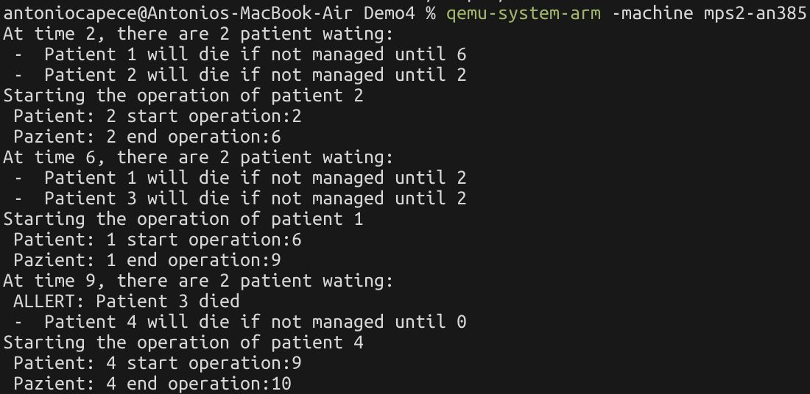
demoHospital2.c - Output
This is the results obtained running the demo.
As we can see, the patient with higher priority (nearest deadline) is chosen to start the surgery operation.
17

Slide 18

18

Slide 19
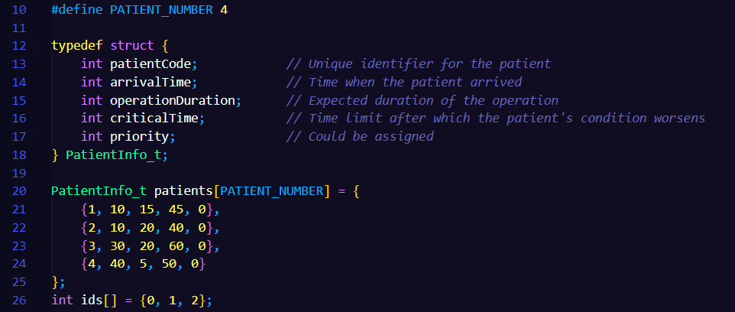
Scheduler
This is the new implemented feature, which aims to better schedule the hospital incoming patients, to show an actual implementation of an hospital.
Each patient (task) is characterized by an ID, arrival time, operation duration (expected), a critical time after which patient’s condition worsens, and a priority.
19

Slide 20
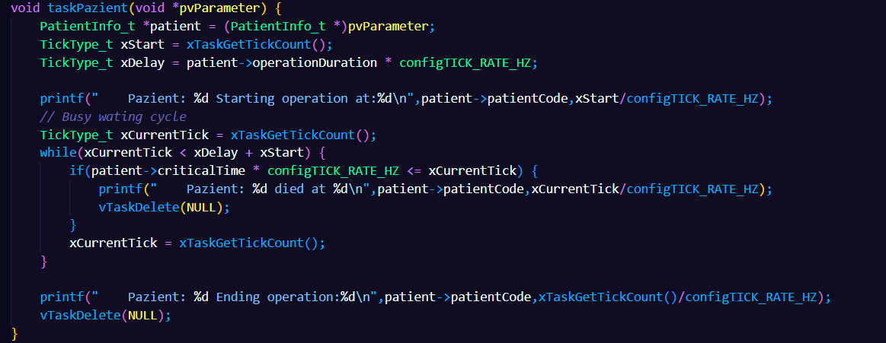
Scheduler
Each aperiodic task (patient) which arrive at a time and based on its critical time, the patient can die or start the surgery operation and occupies the surgery room.
When the operation ends, the patient leave the room.
20

Slide 21
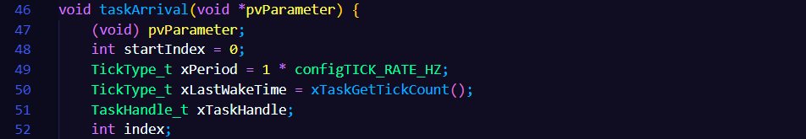
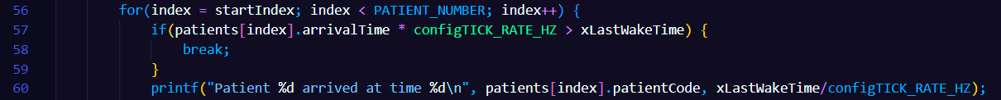
Scheduler
To simulate the arrivals of the patients, it was implemented a periodic task, which is executed every second and creates the patient task.
21

Slide 22
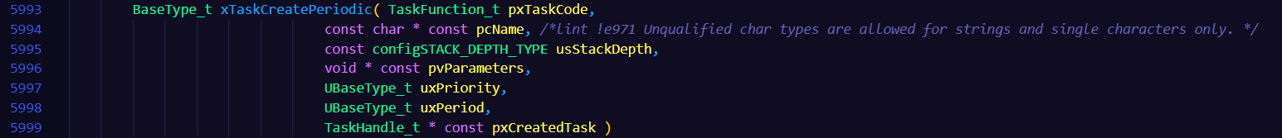
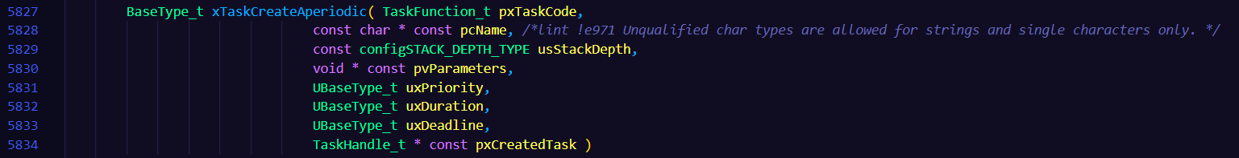
Scheduler
The scheduler simulates a sort of polling server, which iteratively checks if the surgery room is free and if there is a patient ready in the queue.
22

Slide 23
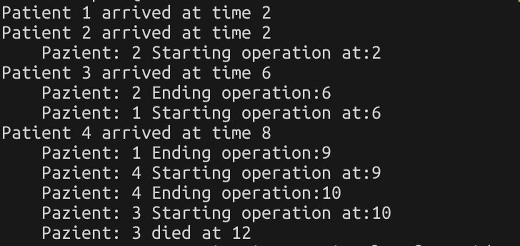
Scheduler - Output
The following output shows the obtained results running the demoScheduler with our scheduler implemented without preemption.
23

Slide 24
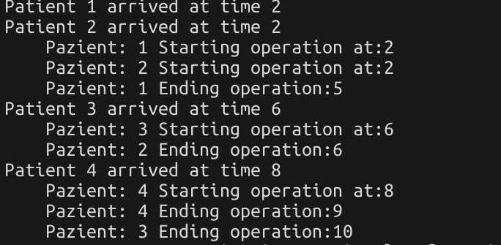
Scheduler - Output
The following output shows the obtained results running the demoScheduler with FreeRTOS scheduler implemented with preemption.
24

Slide 25
Results
FreeRTOS Scheduler With Preemption
Patient | Arrival Time | Starting Operation | Duration | Deadline | Ending Operation | Died (yes/no)
P1 | 2 | 2 | 3 | 9 | 5 | no
P2 | 2 | 2 | 4 | 8 | 6 | no
P3 | 6 | 6 | 4 | 12 | 10 | no
P4 | 8 | 8 | 1 | 10 | 9 | no
Our Scheduler Without Preemption
Patient | Arrival Time | Starting Operation | Duration | Deadline | Ending Operation | Died (yes/no)
P1 | 2 | 6 | 3 | 9 | 9 | no
P2 | 2 | 2 | 4 | 8 | 6 | no
P3 | 6 | 10 | 4 | 12 | - | yes :(
P4 | 8 | 9 | 1 | 10 | 10 | no
25

Slide 26
THANK YOU!
26

